Slide 1
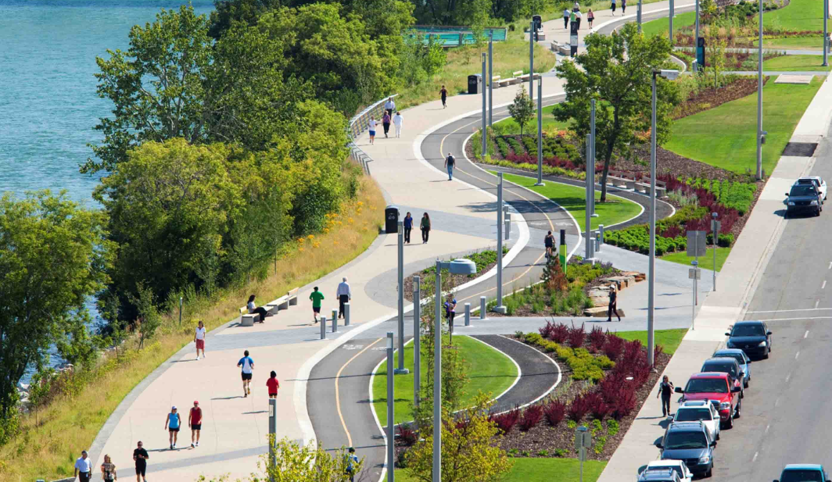
LANDSCAPE ARCHITECTURE

Slide 2
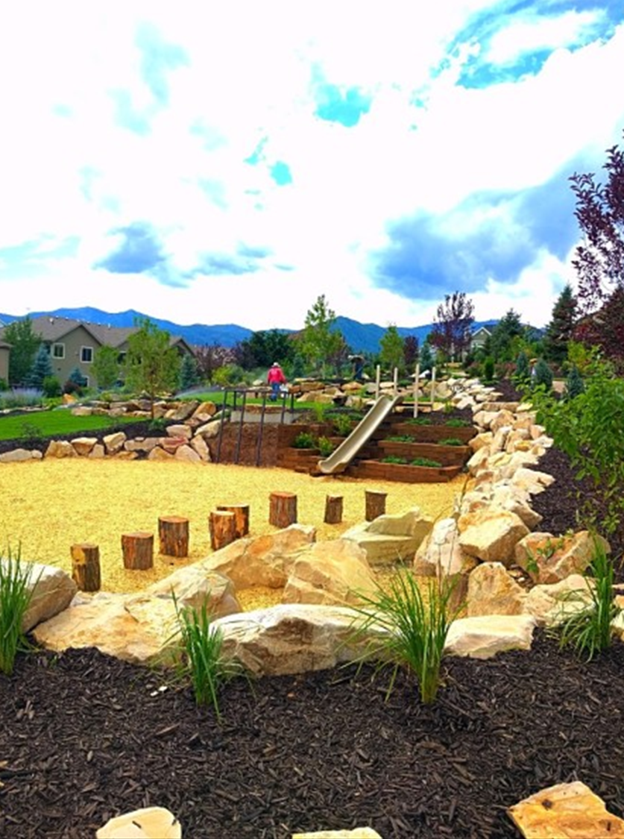
DEFINITION
The art and practice of designing the outdoor environment, especially designing gardenia (outside houses), green belts, lawns, parks or gardens to harmonize with buildings and roads.

Slide 3
WHAT IS LANDSCAPE ARCHITECTURE?
A comprehensive discipline of land analysis, planning, design, management, preservation, and rehabilitation (restoration).
A profession committed to creating healthy, enjoyable and secure places for the future.

Slide 4
A profession that designs, plans and manages our land and its resources.
Landscape architects shape and protect the physical environment in which we live, work and play.

Slide 5
PROJECT TYPES:
Zoos
Parks and Public Areas
Campus Planning
Recreation and Event Spaces
Community Planning
Regional and Natural Areas Planning
Corporate Facilities
Residences, Estates and Ranches
Cultural and Historic Sites
Resource and Environmental Management
Ecological Restoration and Reclamation
Tourism Facilities Planning
Golf Courses
Transportation Planning
Institutional Design and Planning
Urban Planning and Design
Memorials and Sculpture Gardens
Waterfronts and Greenways

Slide 7
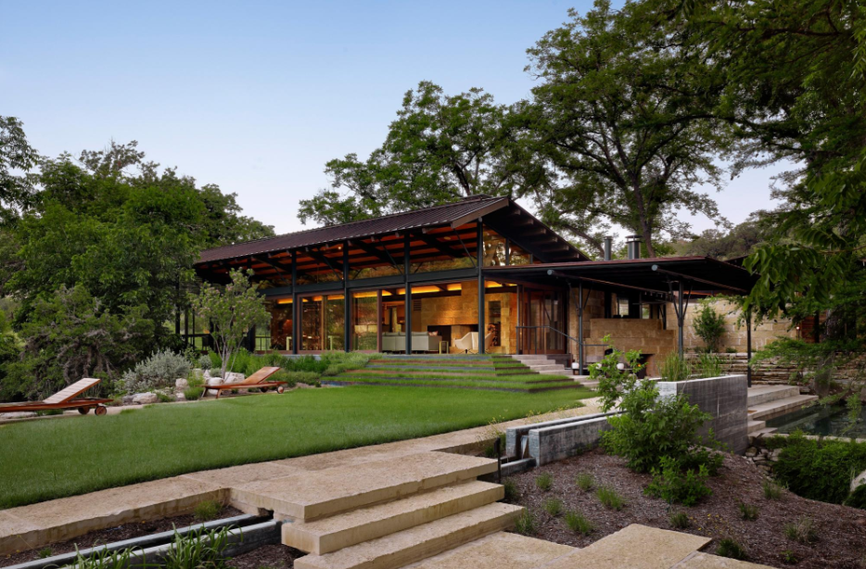

Slide 8
Hazuri Bagh, Lahore

Slide 9
Taj Mahal, Agra, India

Slide 10
Taj Mahal, Agra, India

Slide 11
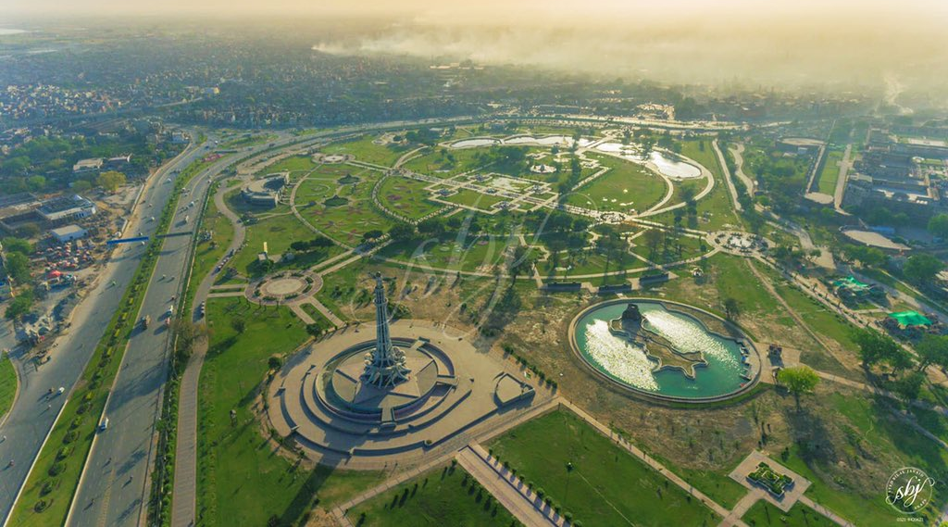
Greater Iqbal Park, Lahore

Slide 12
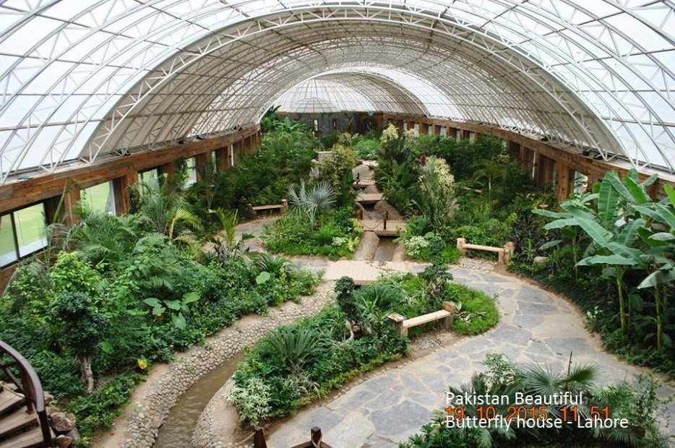
Botanical Garden, Lahore

Slide 13
WHAT IS LANDSCAPE ARCHITECTURE?
NOT JUST ART

Slide 14
WHAT IS LANDSCAPE ARCHITECTURE?
+
ART
SCIENCE =
ECOLOGICAL DESIGN

Slide 15
Two resources of designing landscape architecture
Natural
Man made

Slide 16
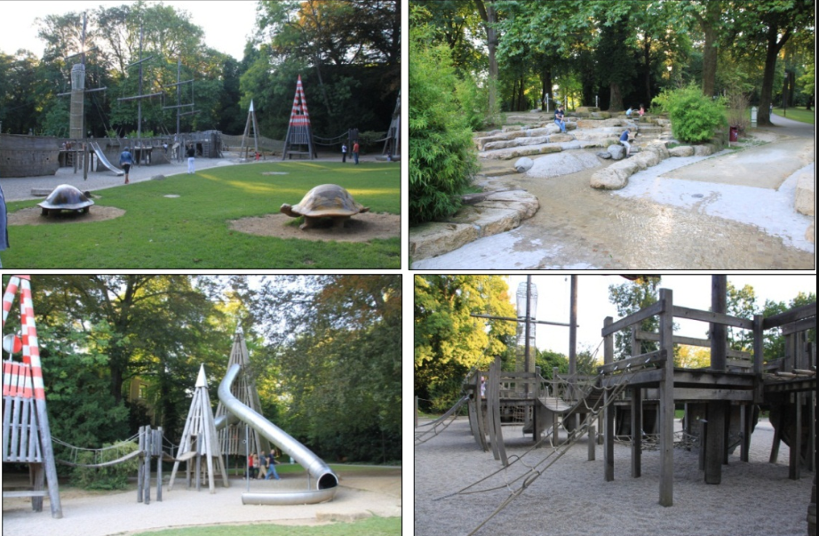
Landscape Architects design outdoor spaces to serve specific purposes and meet certain needs of the users.
Notes:
A landscape architect designs the outdoor space to serve a certain purpose, such as this environmental education garden.

Slide 17
Elements of Landscape Design
Design Elements create moods or feeling of
the Observer.

Slide 18
Elements of Landscape Design: Overview
The five elements of landscape design include:
• Color - It is important to use a complementing color scheme throughout the yard.
• Line - Linear patterns are used to direct physical movement and to draw attention to areas in your garden.
• Form - Form can be expressed through trees and shrubs of various shapes and sizes which create natural patterns.
• Texture - Plants with varying textures can add to the atmosphere of your outdoor area.
• Scale - Your outdoor design should balance the size of the buildings it surrounds, while maintaining a comfortable environment for the individuals who will use the area.

Slide 19
Elements of Landscape Design
Color

Slide 20
Elements of Landscape Design
Line – Continuity of a landscape… Flow of the landscape
Straight lines = direction change
Curved lines= relaxed movement

Slide 21
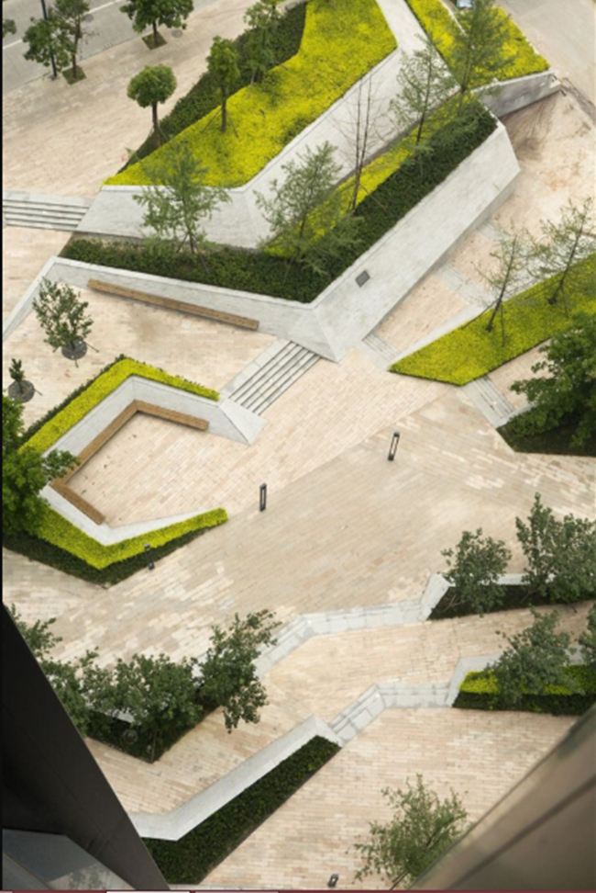
Elements of Design
Form - three dimensionality of geometry or combination of dimensions enclosing volume.

Slide 22
Element of Landscape Design
Texture: Coarse or fine materials used. For example, size differences of
leaves
stones
brick
bark

Slide 23
Elements of Landscape Design
Scale

Slide 24
Principles of Landscape Design
Principles of design- Standards by which designs can be created, measured, discussed and evaluated.
Balance
Focalization
Simplicity
Proportion
Rhythm & Line
Unity

Slide 25
Principles of Landscape Design
Balance: Even distribution of materials on opposite sides of a central axis.
Symmetric – both sides are identical (mirror image).
Asymmetric – visual weight on opposite sides is the same, but materials used and their placement may vary.
Approximate Symmetry – A form of balance achieved by the use of similarly balanced compositional units on either side of a vertical axis within the picture plane.

Slide 26
Symmetrical Balance

Slide 27
Asymmetrical Balance

Slide 28
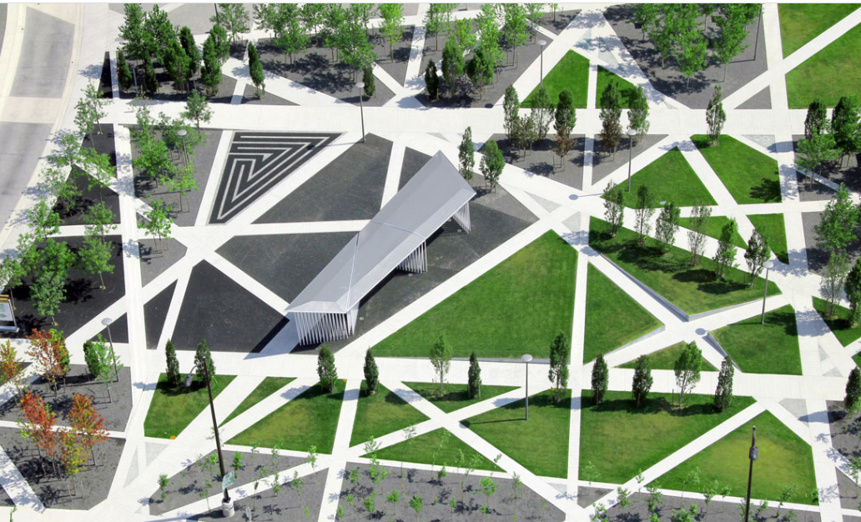
Approximate Symmetry

Slide 29
Principles of Landscape Design
Focalization selects and positions visually strong items into landscape. It catches and draws viewer to key feature in landscape.
Hardscapes
Color movement
Unique plant
or Specimen plant

Slide 30
Hard-scapes

Slide 31
Color movement

Slide 32
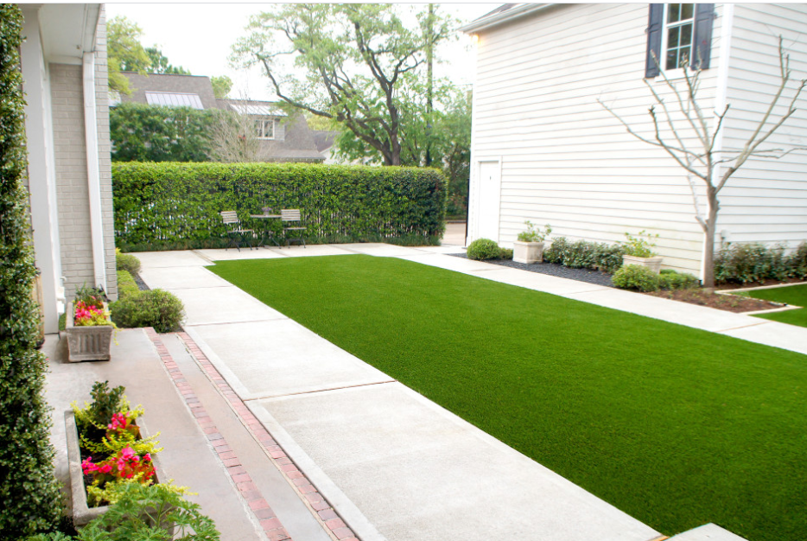
Principles of Landscape Design
Simplicity – Seeks to make the viewer feel comfortable within the landscape.

Slide 33
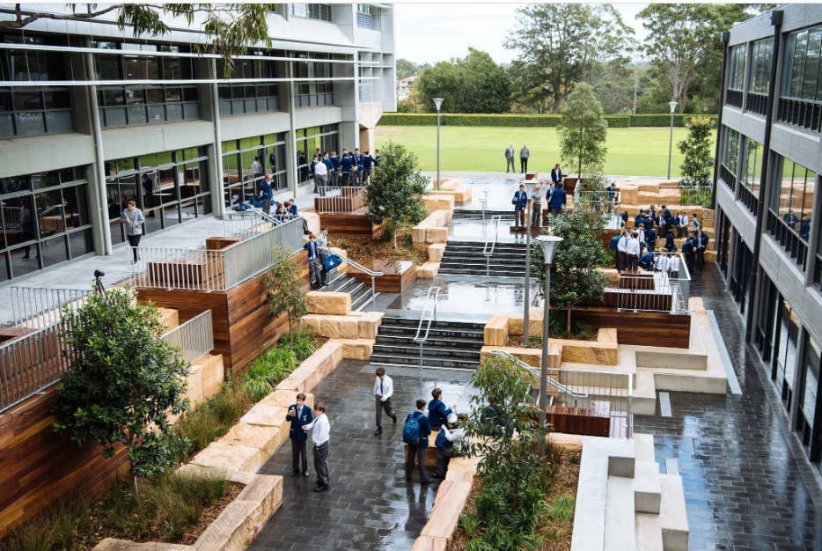
Principles of Landscape Design
Proportion – Concerned with size relationship between all the features of the landscape.

Slide 34
Principles of Landscape Design
Rhythm and Line: When something repeats itself enough times with a standard distance between repetitions, rhythm is established.

Slide 35
Principles of Landscape Design
Unity – The master principle combining all other principles. Total design

Slide 36
WHY ITS IMPORTANT?
With the coming of industrial revolution we witnessed the horrifying effects of population explosion and sudden growth of concrete jungles with abuse and disregard to nature. And unfortunately, we lost the concept of whole ecosystem when man was one with nature. Today, man’s intervention with nature has caused destruction in the environment often upsetting the delicate ecological balance and posing a great danger to the mankind Itself.
We should therefore be conservers and not destroyers of the mother nature and the planet. Good environment is essential for the well-being of the people, for they in turn will collectively contribute to the well-being of the state. It is comparatively recent that the awareness is growing to maintain ecological balance and prevent further environmental pollution.

Slide 37
When man builds, he must take both nature and society into account. With this concept – the ecological approach to landscape architecture-both the natural and man-made environment should be blended to produce a harmonious whole, so that while altering the ‘living system’, the vital inter-relationships between living and non-living things are not distributed. It is with this insight and understanding that the landscape architect plans his work. Therefore, the role of landscape architect and his profound insights into the functioning of the ‘living system’ assumes very much importance nowadays.

Slide 38
Architects, city planners, engineers, scientists and other professionals, can play an important role in environmental protection through collaborative projects and discourse that respect both the needs of people and of our environment.

